Slide 1
MONTHLY MARKET REVIEW AND Forecast FOR JANUARY 2025
TRUSTFUND PENSIONS LTD RESEARCH
FEBRUARY 2025

Slide 2
GLOBAL MARKET REVIEW
INVESTMENT RESEARCH
TRUSTFUND PENSIONS LIMITED
GLOBAL MACRO MOVERS FOR THE MONTH
In January, European stocks outperformed other regions, whilst the U.S’s Artificial intelligence leadership was challenged by China’s DeepSeek.
US shares gained in January but lagged other regions as Chinese start-up DeepSeek challenged US leadership in artificial intelligence (AI). The information technology sector fell but other sectors advanced, with communication services, healthcare and financials among the top gainers.
Eurozone stocks started 2025 with strong gains, outperforming other regions in January. The market benefited from a shift away from U.S. tech stocks and reduced concerns over trade tariffs. Healthcare and financials were among the best-performing sectors, with banks achieving significant returns during the month.
The Nikkei 225 dipped 0.2%, facing increased volatility driven by sharp fluctuations in large-cap technology stocks and underperformance among major exporters.
The NGX ASI gained 153bps to close at 104,496.12 index points, propelled by bullish sentiments on MTNN (+25.0%), PRESCO (+23.2%), ZENITHBANK (+11.2%), and UBA (+10.9%).
*NGX – Nigerian Stock Exchange Mainboard Index
*STOXX Europe 600 – Index that tracks top 600 companies across Europe
*Nikkei 225 tracks top 225 large companies across sectors in Japan
**S&P 500 tracks top 500 companies in USA
Source: Stoxx, (2024), Schroders, (2024) Trustfund Research, (2024)

Slide 3
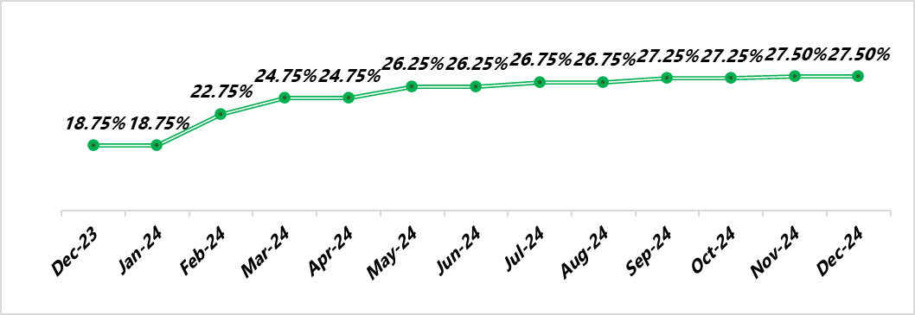
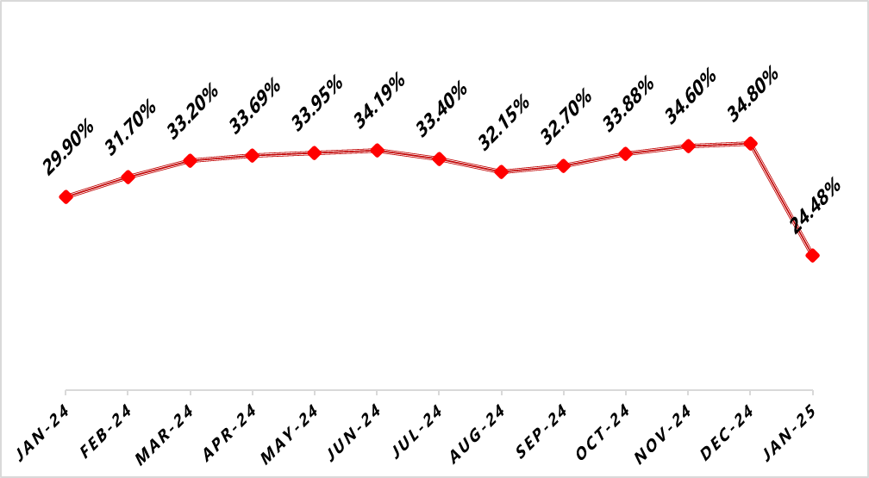
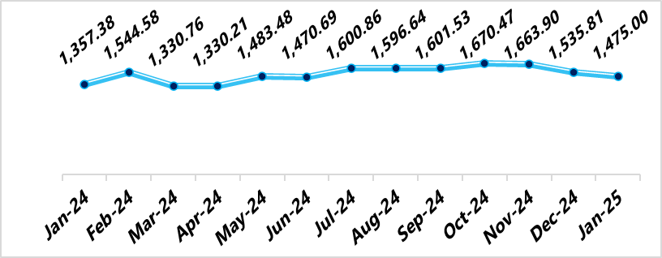
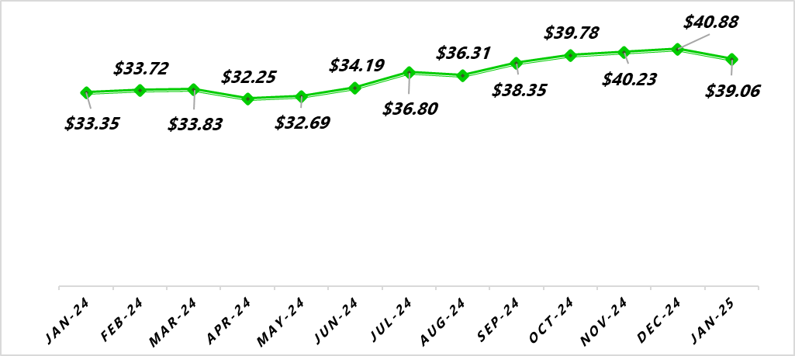
NIGERIAN MACRO REVIEW
MPR
CPI
The MPC’s meeting in February is expected to maintain or slightly raise the MPR, prioritizing stability amid a 10.32% inflation decline post CPI rebasing and a 3.82% Naira appreciation. With upcoming GDP rebasing, the CBN will likely adopt a cautious, data-driven approach for future policy adjustments
Headline inflation slumped by 1032bps to 24.48% following the inflation rebasing exercise. Food and Core inflation closed at 26.08% and 22.59% respectively.
FX RATE
RESERVE
In the official market, the Naira weakened by 3.96% MoM against the U.S. dollar, closing at NGN1,475.22/$1.00. The Naira is expected to maintain its upward trend, supported by the CBN’s continued efforts to stabilize the currency.
In January, the External Reserve increased by 4.45% to $39.06bn from $40.88bn at the end of December 2024. This comes as export levels have been insufficient to offset outflows from fuel imports and FX supply to BDCs.
copyright(c)Trustfund Pensions Limited

Slide 4
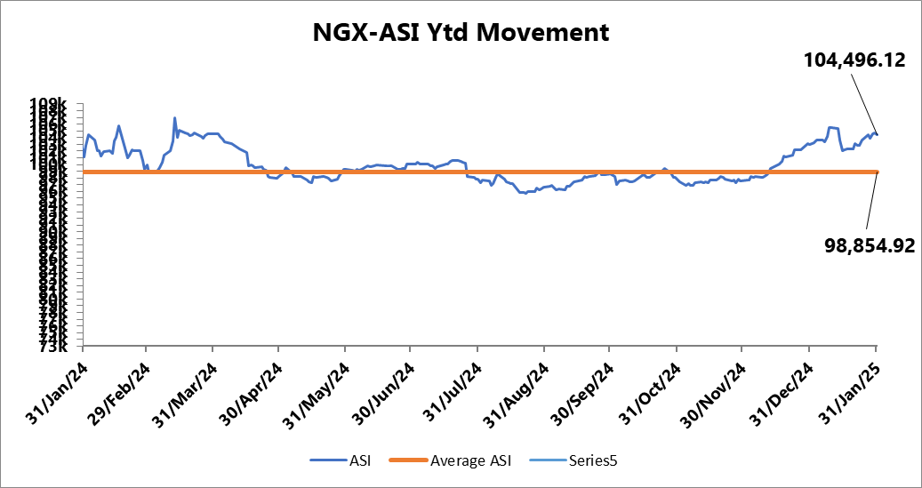
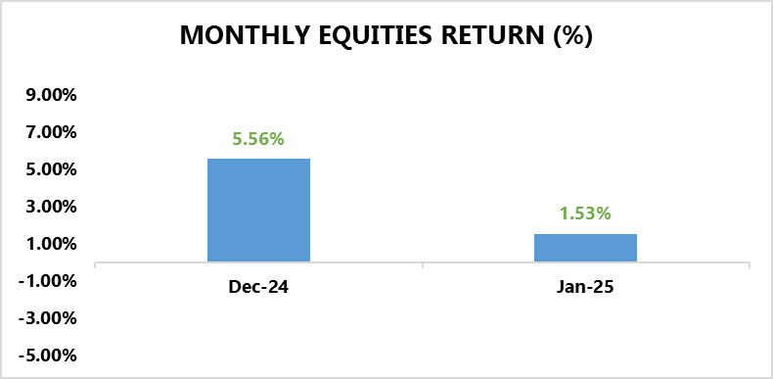
EQUITY MARKET
INVESTMENT RESEARCH
TRUSTFUND PENSIONS LIMITED
Bulls Maintain their Hold on the Bourse
In January, the NGX ASI soared by 153bps to close at 104,496.12 index points, propelled by bullish sentiments on MTNN (+25.0%), PRESCO (+23.2%), ZENITHBANK (+11.2%), and UBA (+10.9%).
Notably, MTNN, the telecommunications giant, saw a rally after the NCC approved a 50% tariff increase for Mobile Network Operators (MNOs), effective January 20, 2025. This marks the first adjustment since 2013, aimed at supporting infrastructure investments, fostering innovation, and improving service quality, network reliability, and coverage for consumers.
A cursory sectoral overview revealed that only 2 out of 5 indices under our purview closed in positive terrain.
The Banking Index was the best preforming index appreciating by 9.76% m/m, driven by share price appreciation in ZENITH (+11.2%) and FIDELITY (+11.1%).
This was followed by the Consumer Goods Index appreciating by 4.46% driven by HONEYFLOUR (+52.1%).
On the flip side, the Industrial Goods Index declined 8.52% MoM due to declines in DANGCEM (-17.7%).
Additionally, Insurance declined by 1.10% from sell offs on SUNUASSURE (-46.5%), and Oil & Gas (-1.61%) slipped amid profit-taking in EUNISELL (-30.0%), and ARADEL (-4.8%).
130.48%) and MRS (63.13%).
Source: Bloomberg/ TFP Research

Slide 5
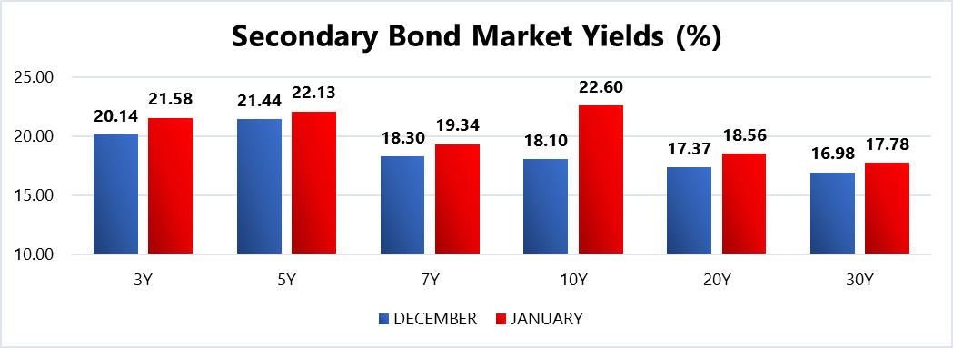
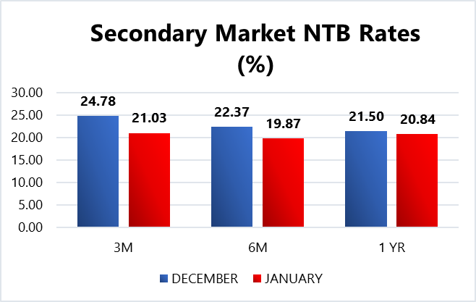
FIXED INCOME MARKET
INVESTMENT RESEARCH
TRUSTFUND PENSIONS LIMITED
The local fixed income market traded in a mixed fashion last month as bearish sentiments were recorded in the FGN bons space, whilst the domestic T-bills space closed bullish.
Consequently, average bond yields gained 93bps to close at 20.69%, whilst average discounted rates on NTBs shed 197bps to settle at 20.93%.
The performance of the secondary bonds space was mainly hinged on JAN-26, MAR-35, and MAR-36 sell offs, whilst the contractions in the NTB space were driven by increased system liquidity from FAAC allocations totalling N1.4trn.
In other news, the DMO held an FGN bond auction during the month offering up to N450.00bn worth of the 18.50% FGN FEB 2031, 19.30% FGN APR 2029 and 22.60 FGN JAN 2035 (new issue) instruments were offered to auction participants. Eventually, the FGN sold approximately N601.04bn worth of these instruments to investors at respective stop rates of 22.50% (prev. 22.00%), 21.79% (prev. 21.14%) and 22.60% (prev. NIL). Notably, the auction drew bids that were 1.49x the offer levels.
Additionally, there were two NTB auctions held in January where a total of N1.05trn worth of the 91 DTM, 182 DTM and 364 DTM bills were rolled over and offered to investors. Eventually, N1.27bn worth of these bills were sold at respective average stop rates of 18.00% (unchanged), 18.50% (unchanged) and 22.21% (prev. 22.85%).
Confidential. Copyright © Trustfund Pensions Ltd

Slide 6
FIXED INCOME MARKET
INVESTMENT RESEARCH
TRUSTFUND PENSIONS LIMITED
Also, subscription levels reached N4.05trn, indicating a bid to offer ratio of 3.88x and a bid to cover ratio of 3.19x.
In February, we expect trading patterns to be driven by the outcome of the upcoming MPC meeting this month. Bearing this, current sentiments are expected to persist as market catalysts remain unchanged. Nonetheless, these are barring any radical global macroeconomic shifts/apex bank interventions/ liquidity shocks to the system.
Confidential. Copyright © Trustfund Pensions Ltd

Slide 7
MARKET OUTLOOK AND STRATEGY
INVESTMENT RESEARCH
TRUSTFUND PENSIONS LIMITED
In January 2025, Nigeria faced rising inflation, reaching 34.8% in December 2024, mainly due to higher food prices. Despite this, the CBN projected 4.17% GDP growth for 2025, supported by economic reforms and increased oil production. Additionally, the government raised the 2025 budget to ₦54.2 trillion and introduced tax reforms to curb inflation while exempting essential goods. February’s outlook remains cautious, with expectations of economic stability driven by fiscal policies, monetary measures, and oil sector improvements. While inflationary pressures persist, the government's proactive stance on revenue generation and price stability provides a foundation for moderate growth and economic resilience.
EQUITY
FIXED INCOME
We anticipate that investor sentiment toward FY’24 financial results will largely influence domestic equities in February. Consumer goods stocks may gain positive momentum, supported by a stronger Q4’24 performance and Naira stability during the quarter. Furthermore, investors seeking dividends are expected to take positions in anticipation of announcements from major dividend-paying stocks. Nonetheless, these expectations are barring any radical global macroeconomic shifts/ apex bank interventions/ liquidity shocks to the system.
Bond – We expect yields to remain elevated as the CBN aims to attract foreign investors by offering competitive returns, whilst managing any liquidity pressures. Thus, will continue to take advantage when suitable opportunities are identified.
Corporate Issuances – our focus will be on available ”A” rated corporate bonds at attractive yields to further boost portfolio return.
Treasury Bills – we expect yields to remain at double digit levels. Thus, we will continue to monitor its trend and take position in yields not less than rates obtainable in money market.
Money Market – We expect rates to taper albeit at double digit levels due to the CPI rebasing exercise and our hold expectations for the MPR. As such, we will be strategic with our positions to maximize the most attractive rates and support our liquidity laddering strategy, whilst ensuring safety of funds.
7
We will continue to take advantage of market opportunities with focus on corporate issuances and alternative assets to improve investment returns. As such, asset exposure may vary over time.
copyright(c)Trustfund Pensions Limited

