Slide 1
MONTHLY MARKET REVIEW AND Forecast FOR NOVEMBER 2024
TRUSTFUND PENSIONS LTD RESEARCH
dECEMBER 2024

Slide 2
GLOBAL MARKET REVIEW
INVESTMENT RESEARCH
TRUSTFUND PENSIONS LIMITED
GLOBAL MACRO MOVERS FOR THE MONTH
In November, global equities expressed mixed sentiments following Donald Trump’s electoral win and emerging market worries over trade tariffs..
U.S. equities surged in November, fuelled by optimism over Trump’s presidential win. Investors welcomed his pro-growth policies, including tax cuts and deregulation. Republican control of Congress strengthened hopes for smooth policy implementation.
Eurozone shares, tracked by the MSCI EMU index, inched 97bps higher in November. Information technology gained, while materials and consumer staples fell. Exporters faced U.S. tariff concerns and weak Chinese demand, though a stronger dollar provided support.
Following Trump’s election, Japanese equities initially rose alongside U.S. markets. However, concerns over potential global tariffs and trade restrictions targeting China weighed on sentiment. This led to underperformance in key Japanese export sectors, including automotive, technology, and basic materials, reflecting fears of disrupted trade dynamics.
The NGX ASI shed 15bps to close at 97,506,.87 index points, triggered by extended profit taking activities amid rising fixed income yields
*NGX – Nigerian Stock Exchange Mainboard Index
*STOXX Europe 600 – Index that tracks top 600 companies across Europe
*Nikkei 225 tracks top 225 large companies across sectors in Japan
**S&P 500 tracks top 500 companies in USA
Source: Stoxx, (2024), Schroders, (2024) Trustfund Research, (2024)

Slide 3
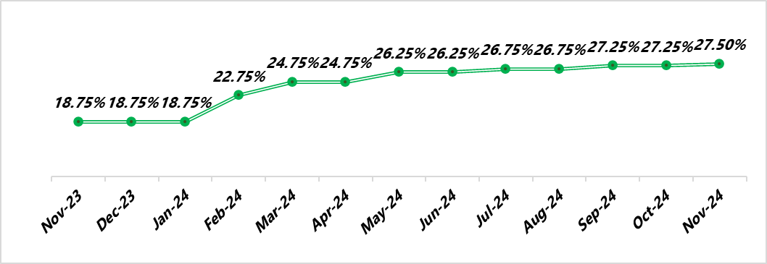
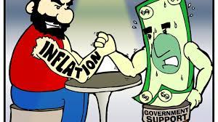
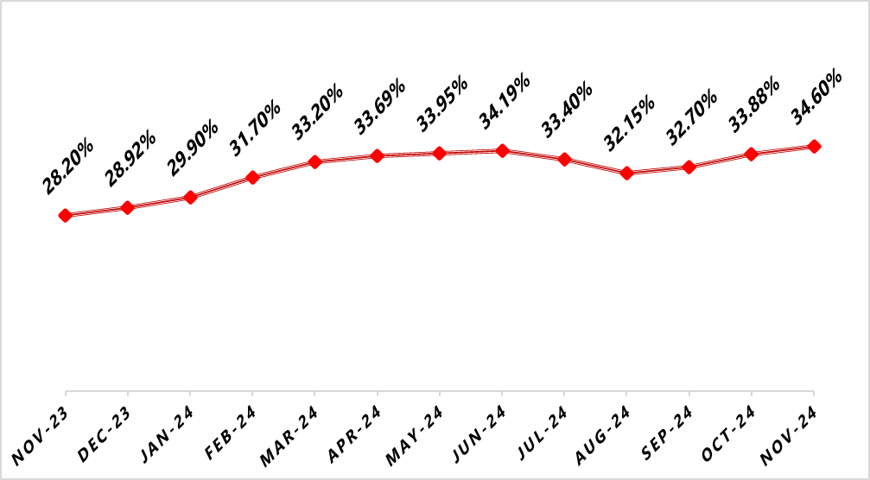
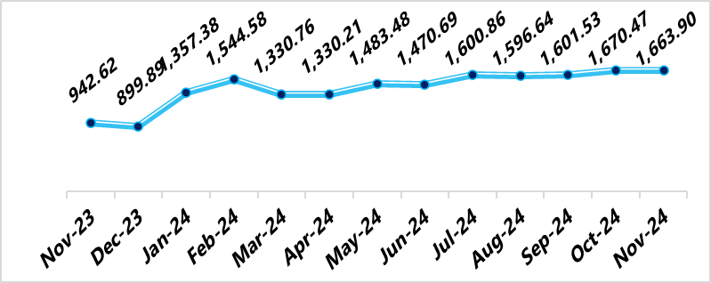
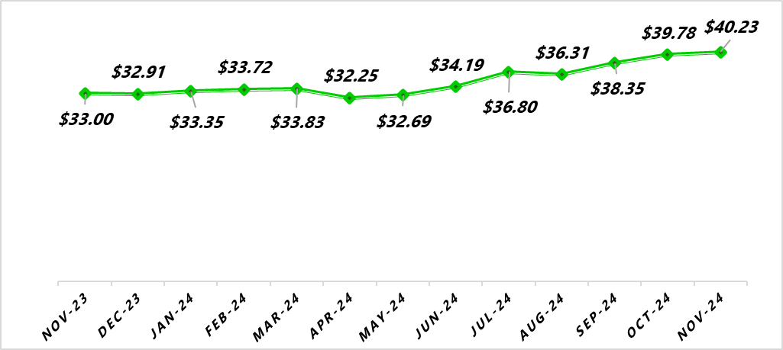
NIGERIAN MACRO REVIEW
MPR
CPI
The Monetary Policy Rate (MPR) was increased by 25bps to 27.50% in November. Notably, this is the least rate hike since February, which suggests an easing in the CBN’s hawkish cycle.
Headline inflation increased by 72bps to 34.60%. This was attributed to increased pressure on food prices during this festive season. Food and Core inflation closed at 39.93% and 28.75% respectively.
FX RATE
RESERVE
The Naira appreciated against the Dollar in the Nigerian Foreign Exchange Market (NFEM). At the close of the month, the Naira exchanged for a dollar at the rate of N1663.93 following increased diasporic inflows to the system.
In November, the External Reserve increased by 1.13% to $40.23bn from $39.78bn at the end of August 2024. This increase can be pegged to foreign capital inflows and crude oil Related Taxes
copyright(c)Trustfund Pensions Limited

Slide 4
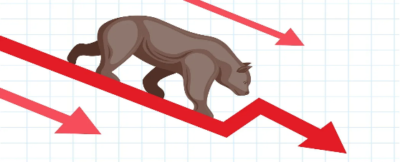
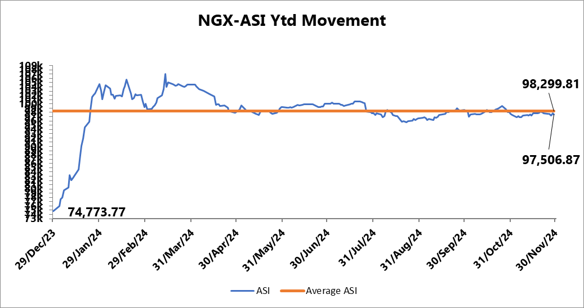
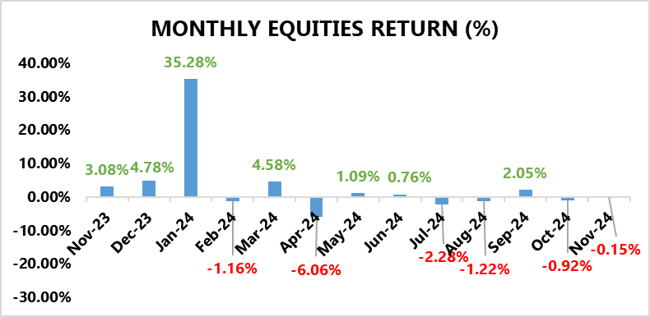
EQUITY MARKET
INVESTMENT RESEARCH
TRUSTFUND PENSIONS LIMITED
Profit Taking Activities And Rising FI Yields Pressure the NGX ASI Lower
In November, the NGX ASI shed 15bps to close at 97,506,.87 index points, triggered by extended profit taking activities amid rising fixed income yields.
A cursory sectoral overview revealed that all the indices under our purview closed in positive terrain.
The Banking sector took the lead with a 3.39% gain driven by positive sentiments on ZENITHBANK (+11.39%) and UBA (+9.73%).
Following closely was the Oil & Gas index with a 3.20% gain, despite price losses in SEPLAT (-7.02%) and OANDO (-27.55%).
Furthermore, the Consumer Goods sector and Industrial Goods sector also recorded notable growth, rising by +2.40% MoM and +2.14% MoM, respectively. This can be attributed to gains in FLOURMILL (+30.81%) and WAPCO (+50.65%).
Source: Bloomberg/ TFP Research

Slide 5
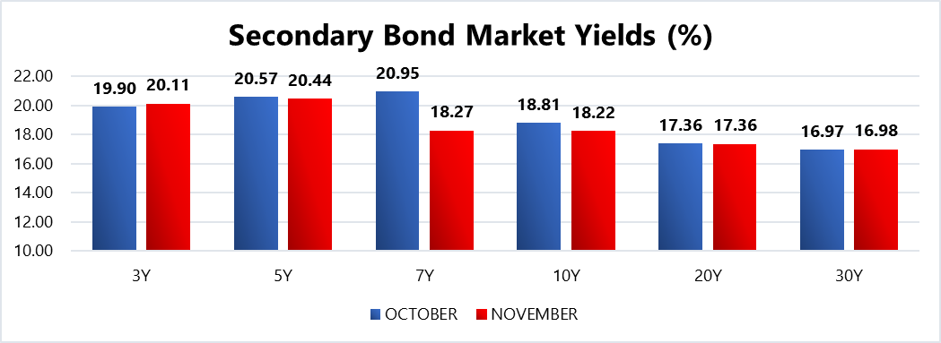
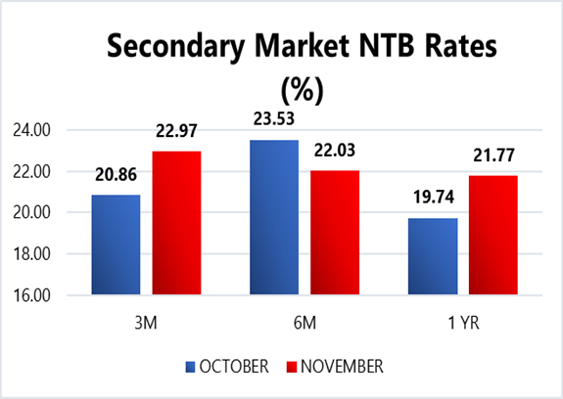
FIXED INCOME MARKET
INVESTMENT RESEARCH
TRUSTFUND PENSIONS LIMITED
Sentiments were mixed in the fixed income market as the bond market expressed slight improvements with a 3bps decline in average yields to 19.46%, whilst bearish trading led to an 82bps uptick in NTB average discounted rates to 22.49% MoM.
In other news, the DMO held an FGN bond auction during the month where up to N120.00bn worth of the 18.50% FGN FEB 2031, and 19.30% FGN APR 2029 instruments were offered to auction participants (same as last month’s instruments on offer). Eventually, the FGN sold approximately N346.16bn worth of these instruments to investors at respective stop rates of 22.00% (prev. 21.74%) and 21.00% (prev. 20.75%). Notably, the auction was 3.08x oversubscribed.
Additionally, there two NTB auctions held in November where a total of N1,124.23bn worth of the 91 DTM, 182 DTM and 364 DTM bills were rolled over and offered to investors. Eventually, N1,319.38bn worth of these bills were sold at respective average stop rates of 18.00% (prev. 17.00), 18.50% (prev. 17,50%) and 23.25% (prev. 20.26%). Also, subscription levels reached N1,847.10bn, indicating a bid to offer ratio of 1.64x and a bid to cover ratio of 1.40x.
Notably, stop rates closed higher in both the NTB and Bond auctions with demand skewed to the longer dated instruments. This suggests investors’ strategies to lock in higher yields for longer tenors based on the speculation of easing rate hikes by the apex bank.
Confidential. Copyright © Trustfund Pensions Ltd

Slide 6
FIXED INCOME MARKET
INVESTMENT RESEARCH
TRUSTFUND PENSIONS LIMITED
This was evident in the smallest and most recent rake hike in the MPR by 25bps to 27.50% since the hawkish cycle began, indicative of an imminent pause or rate cut in the near term.
In December, we expect comparatively stable market conditions with elevated yields. Nonetheless, these are barring any radical global macroeconomic shifts/apex bank interventions/ liquidity shocks to the system.
Confidential. Copyright © Trustfund Pensions Ltd

Slide 7
MARKET OUTLOOK AND STRATEGY
INVESTMENT RESEARCH
TRUSTFUND PENSIONS LIMITED
In November 2024, Nigeria's economy faced high inflation at around 33.95%, driven by elevated food and energy costs despite monetary tightening efforts by the Central Bank. Fiscal reforms boosted government revenues from oil and non-oil sectors, supported by higher crude oil prices and refining capacity. The naira remained volatile amid forex reforms, while agriculture and ICT contributed to GDP growth, projected at 2.98% for the year (PWC, 2024). December 2024 is expected to see incremental economic stability as reforms gain traction, though risks like public debt, exchange rate pressures, and inflation persist. Policy alignment remains vital for sustained growth
EQUITY
FIXED INCOME
Bond – We expect yields to remain elevated as the CBN aims to attract foreign investors by offering competitive returns. Thus, will continue to take advantage when suitable opportunities are identified.
Corporate Issuances – our focus will be on available ”A” rated corporate bonds at attractive yields to further boost portfolio return.
Treasury Bills – we expect yields to taper due to a liquid financial system, albeit remain at double digit levels.As such, we will continue to monitor its trend and take position in yields not less than rates obtainable in money market.
Money Market – As rates continue to dwindle, we will be strategic with our positions on the short end of the curve to maximize the most attractive rates and support our liquidity laddering strategy, whilst ensuring safety of funds.
We expect the market to trade in a mixed fashion this month as “Santa rally” traders duel with cautious investors. In other words, there exists the possibility of capped gains from recent rallies due to profit taking activities following portfolio adjustments. Therefore, we expect significant activity on sound Banking, Oil & Gas and industrial stocks. Nonetheless, these expectations are barring any radical global macroeconomic shifts/ apex bank interventions/ liquidity shocks to the system.
7
We will continue to take advantage of market opportunities with focus on corporate issuances and alternative assets to improve investment returns. As such, asset exposure may vary over time.
copyright(c)Trustfund Pensions Limited

